Slide 1
What should Eniac’s strategy be concerning discounts?
Presented by: Florian, Sadia, Sam, Hajer

Slide 2
Eniac’s Insights
Total Revenue
Time Frame
Revenue Per Order
Average Discount
8 Million €
Jan 2017 -
Mar 2018
194 €
21.3%

Slide 3
Pro discount (Merits)
Discount Improves
Customer acquisition
Satisfaction
Retention
Allow the company to grow

Slide 4
Contra Discount (Demerits)
Increases number of orders, but decreases in total revenue
Emphasizing in quality products rather than competing to offer lowest prices

Slide 5
Seasonality:
Impact of Christmas & Black Friday

Slide 6
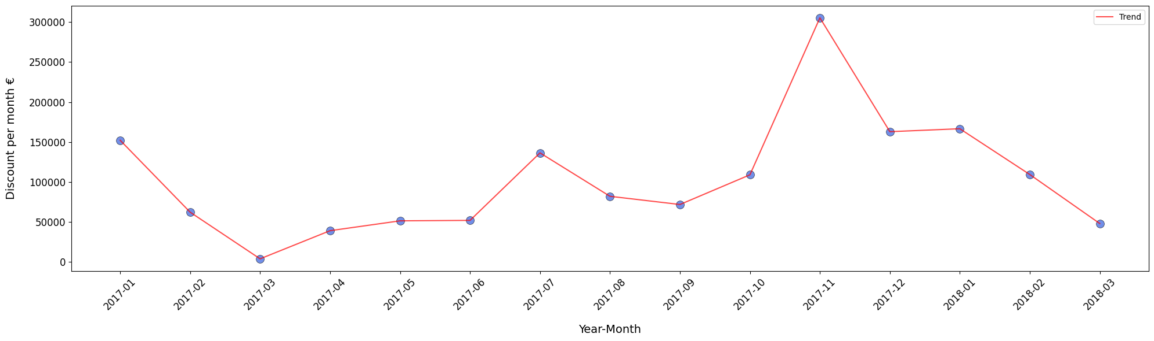
Decoding Discount Dynamics: A Seasonal Snapshot
November:
Black Friday/week!

Slide 7
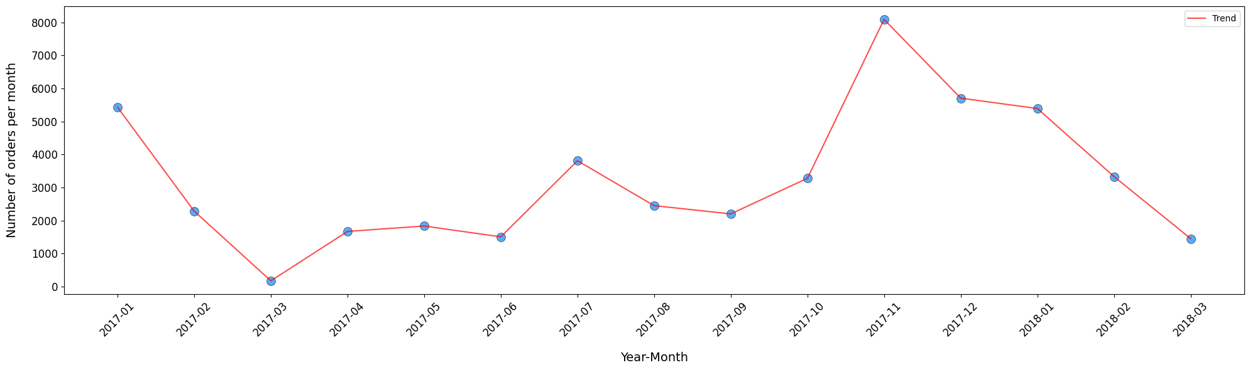
Monthly Orders in Harmony with Discounts
November:
Black Friday/week!

Slide 8
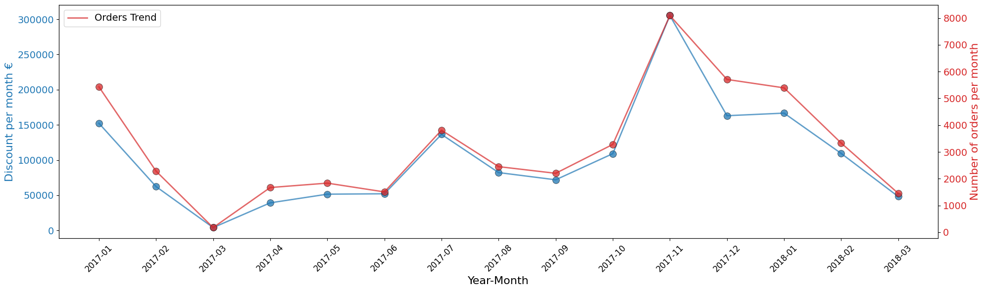
Monthly Orders in Harmony with Discounts
November:
Black Friday/week!

Slide 9
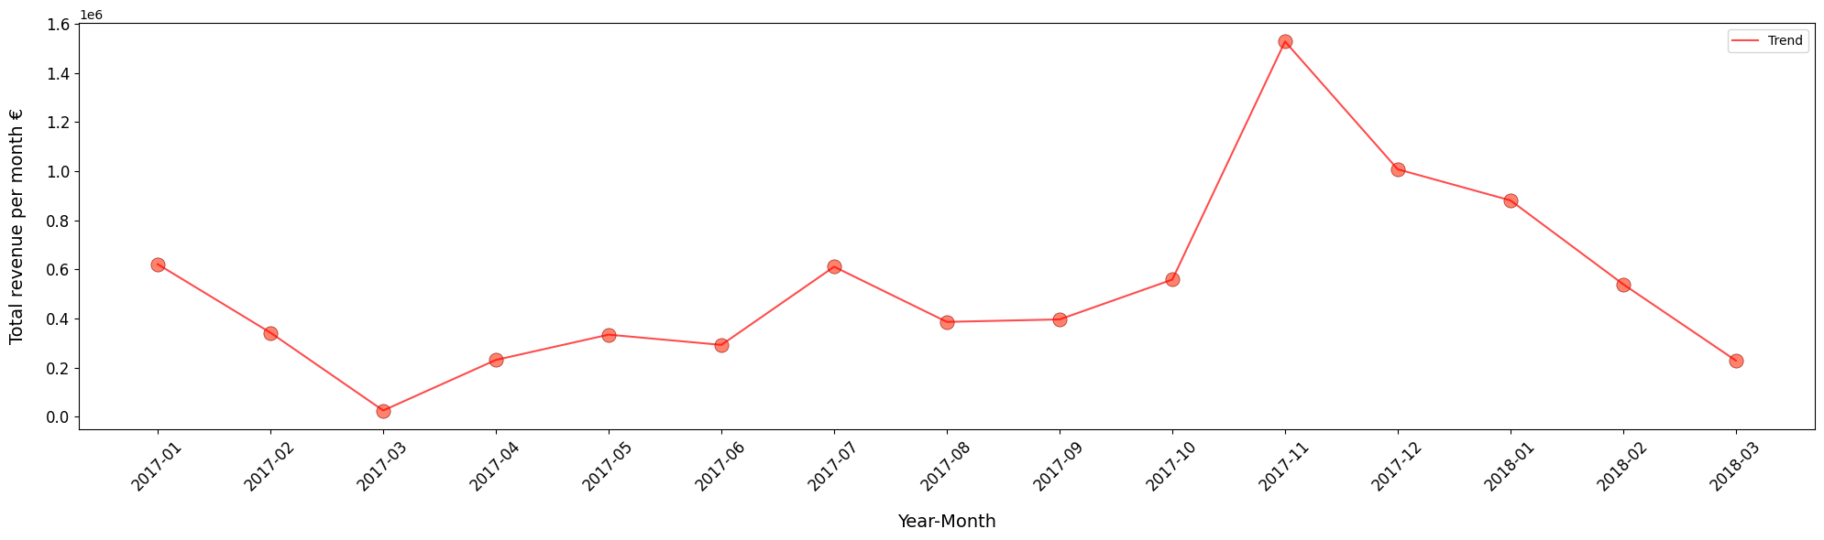
Harvesting the Fruits of Seasonal Strategies
November:
Black Friday/week!

Slide 10
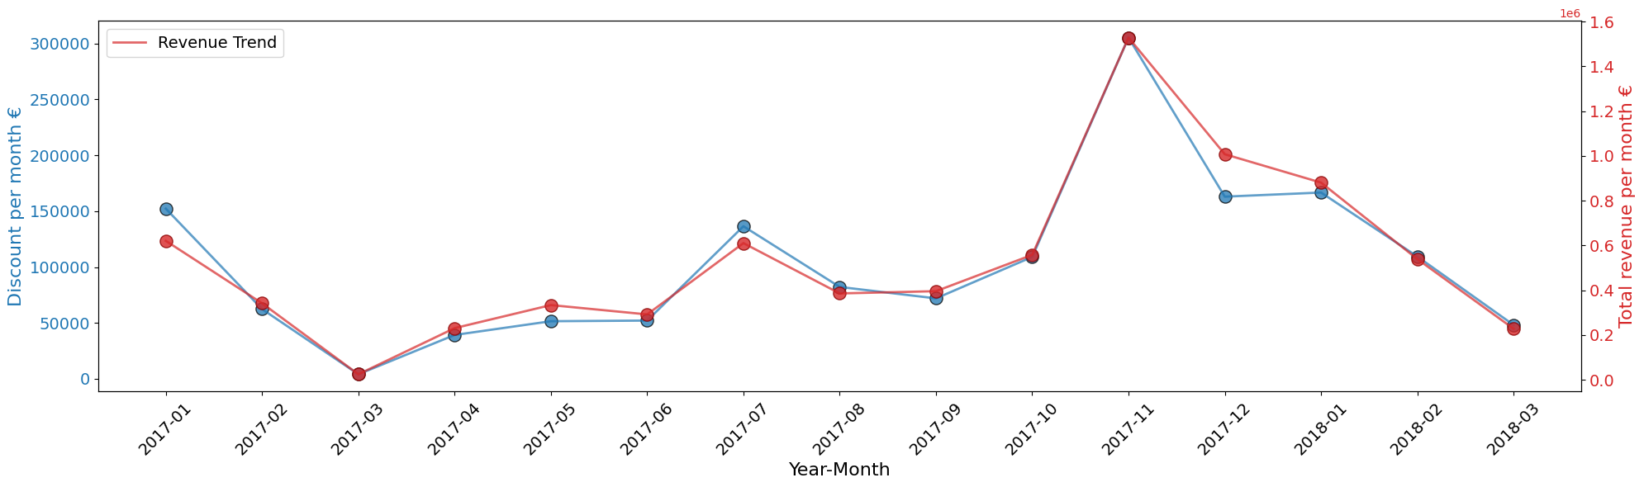
Harvesting the Fruits of Seasonal Strategies
November:
Black Friday/week!

Slide 11
Category

Slide 12
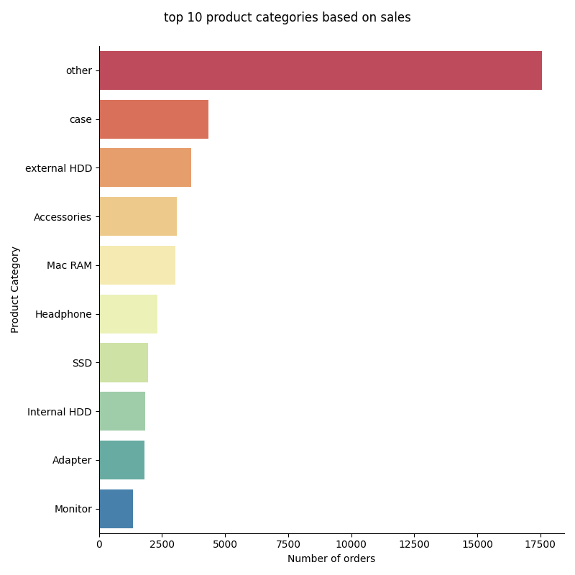

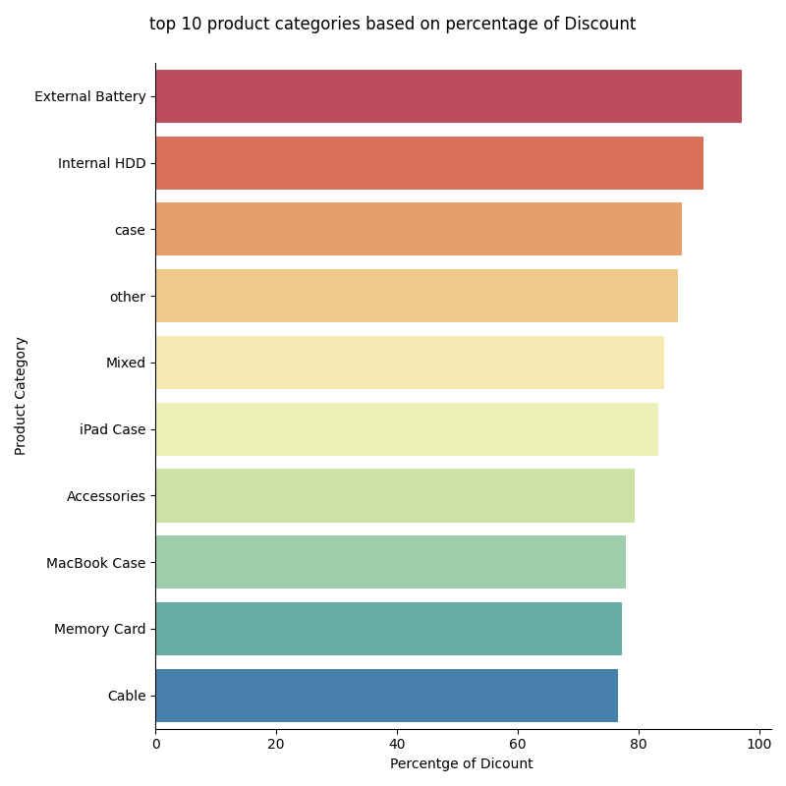
Maximum discounted products do not produce most of the revenue

Slide 13
Discount strategy for products in not-new condition
2%
4.6%
31%
Products: Refurbished/ Reconditioned/ Like New
Revenue comes from this category
Average discount is applied on not new products
25% : Refurbished Products
37% : Reconditioned Products
33% : Like New Products
Solution: Incrementally decrease discount to maintain revenue

Slide 14
Insights

Slide 15
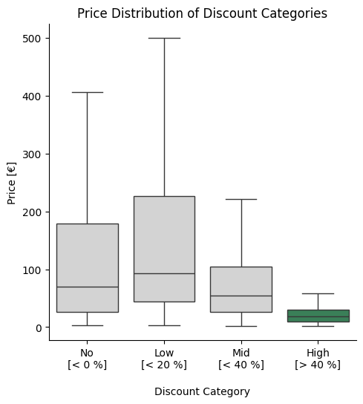
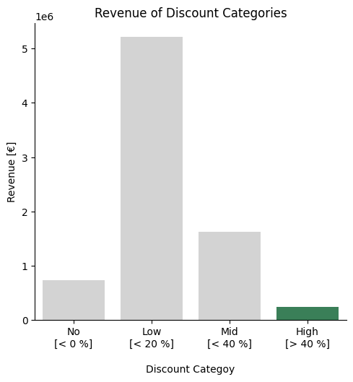
High Discounts in low priced products

Slide 16
Foresight

Slide 17
Eniac is growing!
Q1-2017 → Q1-2018
+ 29 %
orders growth rate
66 %
revenue growth rate
+ 22 %
revenue per order growth rate
Disclaimer: no complete data for Q1-2018

Slide 18
Conclusion
Numbers point to the fact that discounts do not harm revenue
We recommend to lower discounts
High sales season (Black Friday/Christmas)
On high impact product categories
We recommend discounts
on accessories and products in the lower price range to attract new customers

Slide 19
Data collection should be improved!
Customer ID
Purchase costs of Products
(mean) Competitor Prices
detailed Product Categories
A/B testing for discounting products!

